Slide 1


Novice Briefing 2026
Notes:
Avoid karaoke slides – you want people to be listening to what you say rather than just reading off the screen.
Make sure you are asking questions throughout to ensure audience is paying attention.
Have fun – people will be nervous about their first rally, help them feel at ease!
Ensure that people have their roadbooks with them – you may have some extra things to look out for to tell them.
Depending on your rally’s organisation, you may be running different time card rules – edit this PPT to suit you better.
Ensure you have a system in place for completing R1-R2 licence upgrade forms.

Slide 2
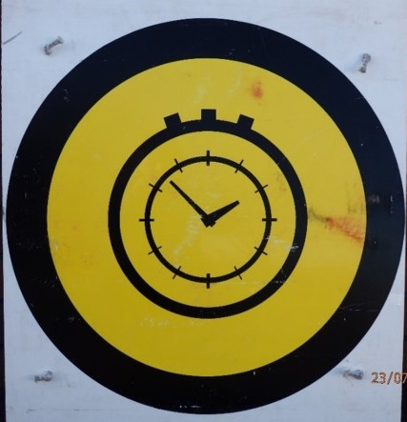
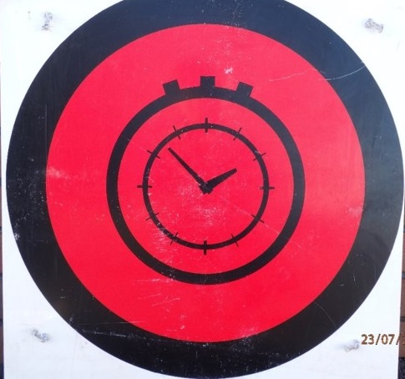
At the start of the stage:
Start of Control Area sign – at the start of a stage or leg
Stage Control sign – at the point where the time cards are being marked.

Slide 3
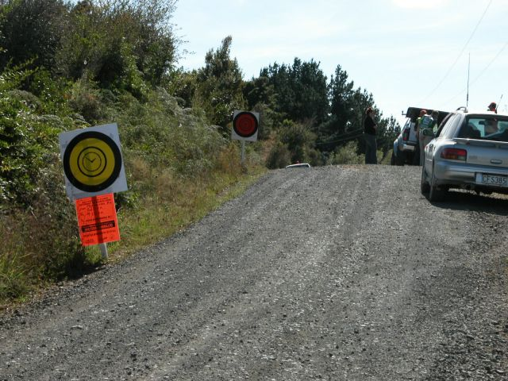
START OF STAGE
Control – Red
This is where you hand the time card out and where you activate the in-car check in process.
Start of control Area – yellow
Notes:
.

Slide 4
At the stage start:
Keep car to one side of road before yellow control sign to allow for late cars and emergency vehicles access.
Keep car outside yellow control board until 1 min before check in time. E.g. Check in time 8:30, co-driver bring car in on 8:29:01
Do not use your Rallysafe to check in until it is your due check in time.
Once checked in, both in car ready to go (you will have a minimum of 3min before starting stage)

Slide 5
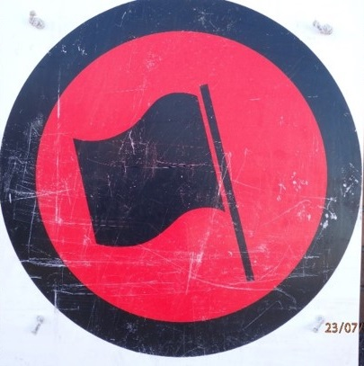
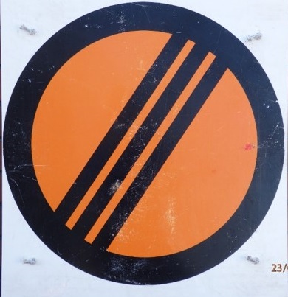
Start line – follow marshals instructions as to how far up you can go.
De-control sign. Signals the end of the control area.

Slide 6
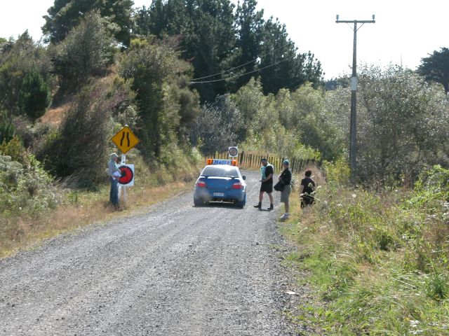
Decontrol - beige
Start Line – Red

Slide 7
On the start line:
Don’t sit right behind car on start line
Promptly move up to start line when your turn
Start line official will issue your start time, please write this on your time card. Your Rallysafe will count down.

Slide 8

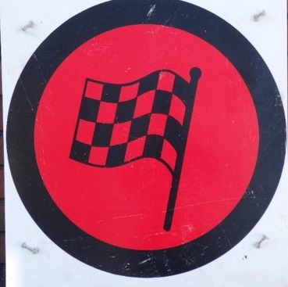
200m finish line warning board – yellow x 1 only
Flying finish boards - red x 2 (one either side of road)

Slide 9
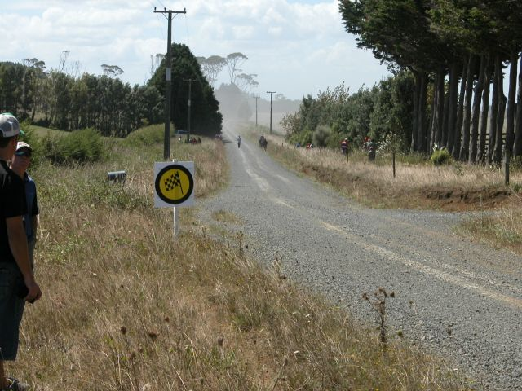
Finish 200m warning board

Slide 10
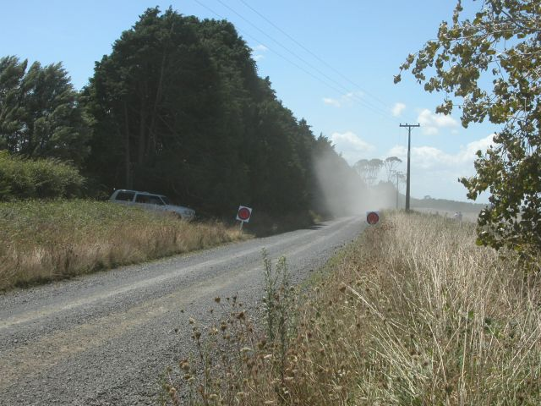
Flying Finish – Red
Notes:
This is the time to slow down safely ASAP

Slide 11
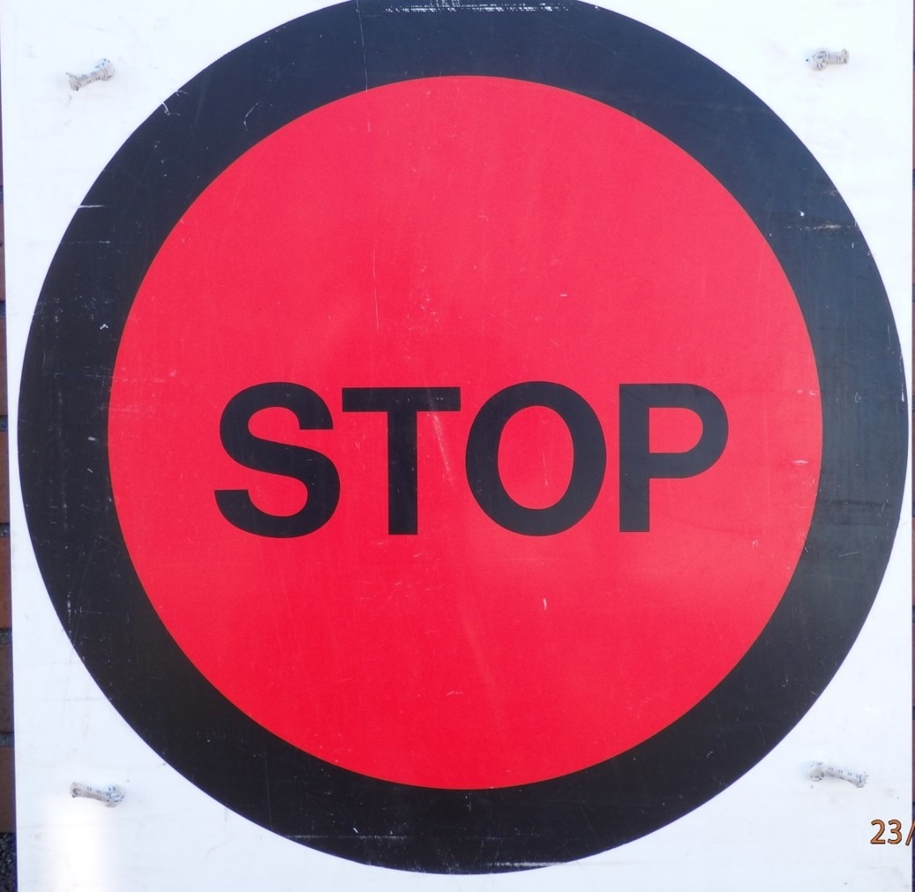
Finish Stop Control board - Red

Slide 12
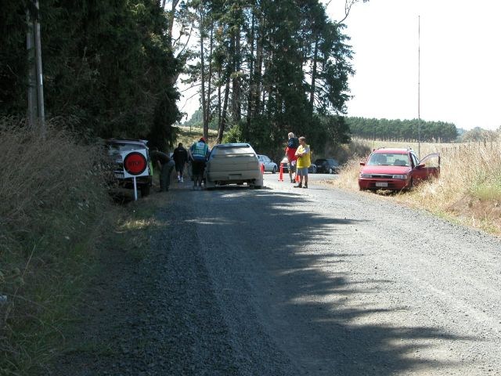
Finish Stop Control

Slide 13
At the finish control
You MUST stop at the stop sign
You MUST remove helmets.
Please write down ‘Actual Finish Time’ and ‘Stage Time’ on your time card. The info is on your rallysafe unit
Notes:
Edit this slide if your timing crew is not expected to be giving stage times

Slide 14
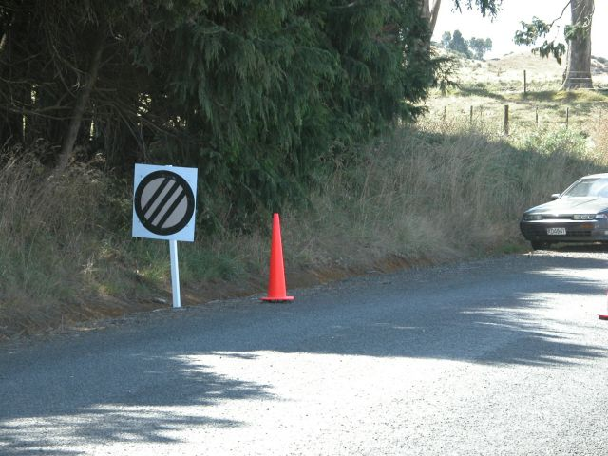
Decontrol sign – signalling the end of a control Area

Slide 15


In Stage Signs in this Rally:
Safety Radio Point 100m warning board - Yellow
Safety Radio Point Board - Blue
Notes:
Any other signs to be used on your rally, add photos and explanations here.

Slide 16

Directional/Warning Signs
Warning Directional Arrow – Green Base Red Tip
100m prior to junction
Both of these arrows are Sky Blue on the reverse – if you see a blue sign you are going the WRONG WAY!
Directional Arrow – Red – At junction
Warning Sign – 100m prior to hazard
Additional Arrow – White on face
Sky Blue on reverse.
Used for additional instructions
not noted in the route book
Hazard Sign

Slide 17
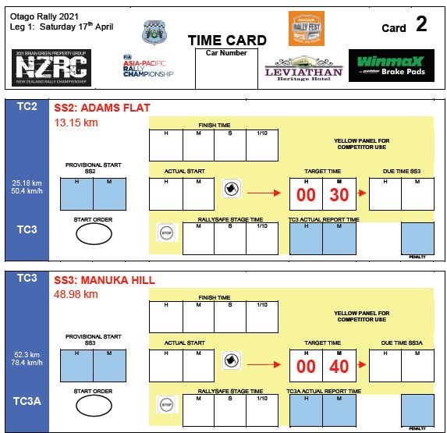
Always remember to write your car number on each page
This figure entered by co-driver by adding
ACTUAL START TIME
to
TARGET TIME
Follow the arrows
The figures in the white and blue boxes are entered by the timing crews

Slide 18
Service
To calculate how much time you have for service when service time is included in your target time, do the following:
Calculate the distance you have to go to the next control e.g. 4km
Allow 1 minute per km to tour there e.g. 4 mins plus a bit just in case - 6 mins
Take the result (6 mins) off your due report time to the next control - e.g. due report time is 1045 minus 6 = 1039. This is the latest time you can leave service to get to the next control.
Always do this calculation straight away and note the time for leaving down somewhere so you don’t forget.
Notes:
This should be removed if using service parks

Slide 19
Stopped in Stage - OK
If possible park in a safe place
If you do not need assistance, press the OK button on your RallySafe unit, put out your safety triangle and show your ‘OK’ sign to at least next 5 cars, then leave so all other cars can see it
If you are in a hazardous position press “HAZARD”
Always put your safety triangle out to give following cars sufficient time to slow down
Don’t go too far from car (fire danger etc)
You MUST have your withdrawal form filled out BEFORE sweeper car arrives

Slide 20
Stopped in Stage - SOS
RallySafe unit will transmit Automatic SOS after a high G impact
If you DO NOT need assistance you must press “OK”. Then press “HAZARD” if in unsafe place.
If you DO need assistance RallySafe has already sent the signal.
If you are able to, display ‘SOS’ in case of fire or injured/trapped crew member
Stop sufficient vehicles to assist then put out the ‘OK’.
Ensure someone completes the injury accident checklist (in the rear of your roadbook) and takes the information to the next radio point.

Slide 21
It is MANDATORY to stop for ‘SOS’ or where you cannot see any movement around the car – And remember to put your safety triangle out
If both crew incapacitated next vehicle displays ‘SOS’ And Triggers Rallysafe “SOS”
Contact HQ via phone or radio (normally the next car) and that may mean driving to the finish control or radio point

Slide 22
1 person always stays with car while other investigates
Discuss how you will handle an emergency situation between yourselves.
Remember the first time you have to deal with this it will be for real – not a practice.
This is the most fundamental principle of rally safety – you are the first responder.

Slide 23
Touring
Don’t speed or drive erratically and KEEP LEFT
Make sure your service crew understands that they can get YOU penalties!
Traffic offences must be reported to an official! – including service crews
Lights on in forests
Outside of the service park is ‘no service’ area
Notes:
Note: can change servicing requirement if necessary

Slide 24
Remember!
To withdraw officially if withdrawing
Don’t stress or panic – RELAX
If in doubt - ASK
Drive to the conditions/car and ability
Make sure nothing will fly around in car – drink bottles, time cards etc
HAVE FUN!

Slide 25
Rallysafe Briefing

Slide 26
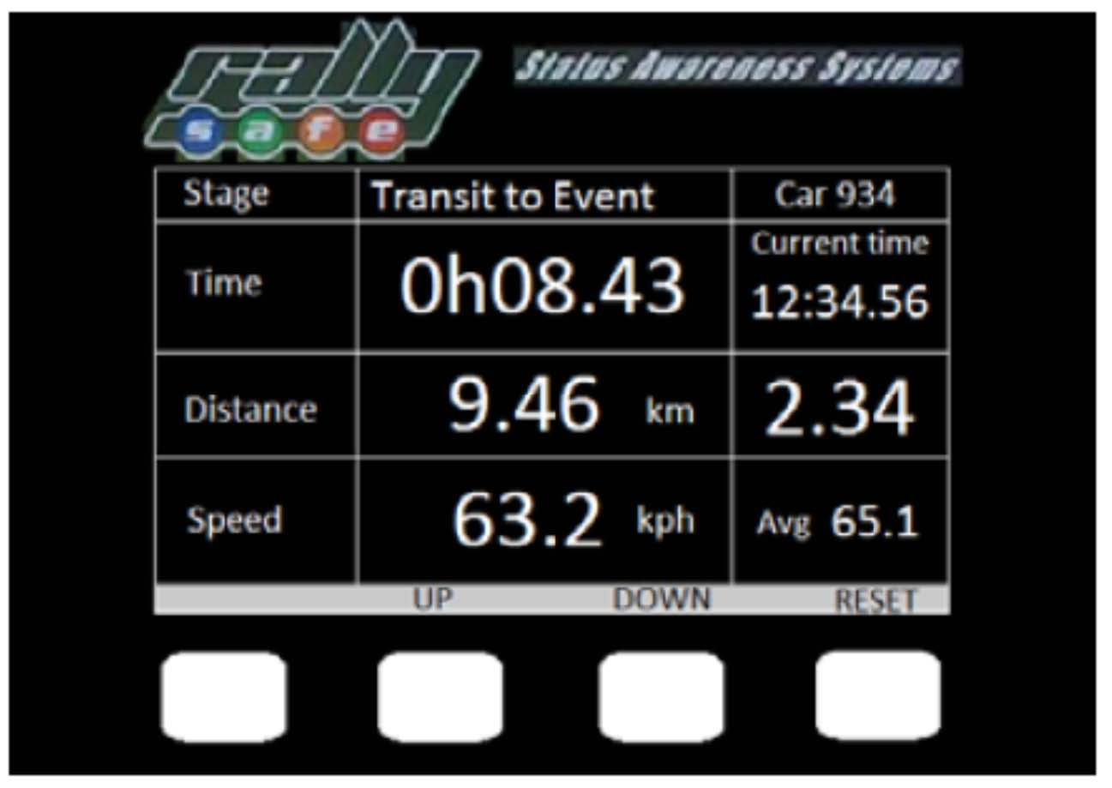
The Transit Screen
Shows :
Car number
Time travelled
Rally time of day
Distance travelled – total and split
Actual speed and average speed
Four buttons along the bottom allow you to select the menu, up, down and reset the odometer split distance

Slide 27
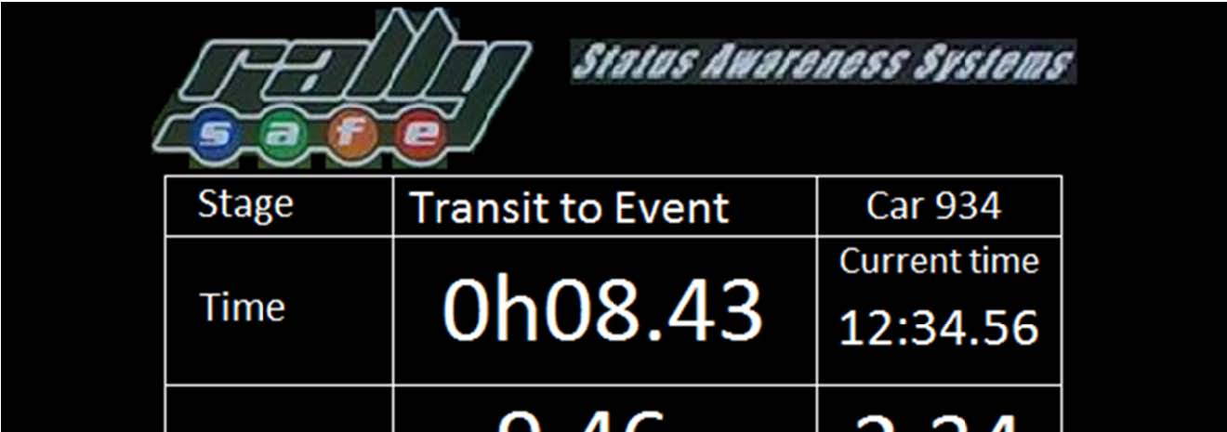
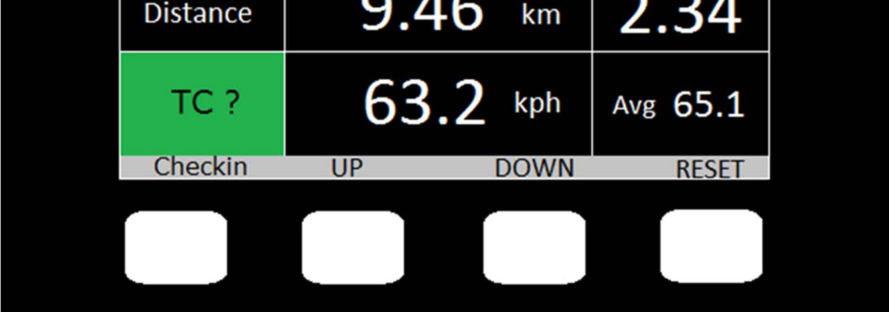
The Time Control (TC) Screen
When you get to a time control green square highlights
When you are at the TC and have handed in your time card, push the “Checkin” button.
This is the electronic equivalent of the time control marshal writing on your timecard.
You will NOT get any response in reply
Please only push the button ONCE
REMEMBER – Rallysafe does not take the place of your timecard. Treat it as an electronic time card.

Slide 28
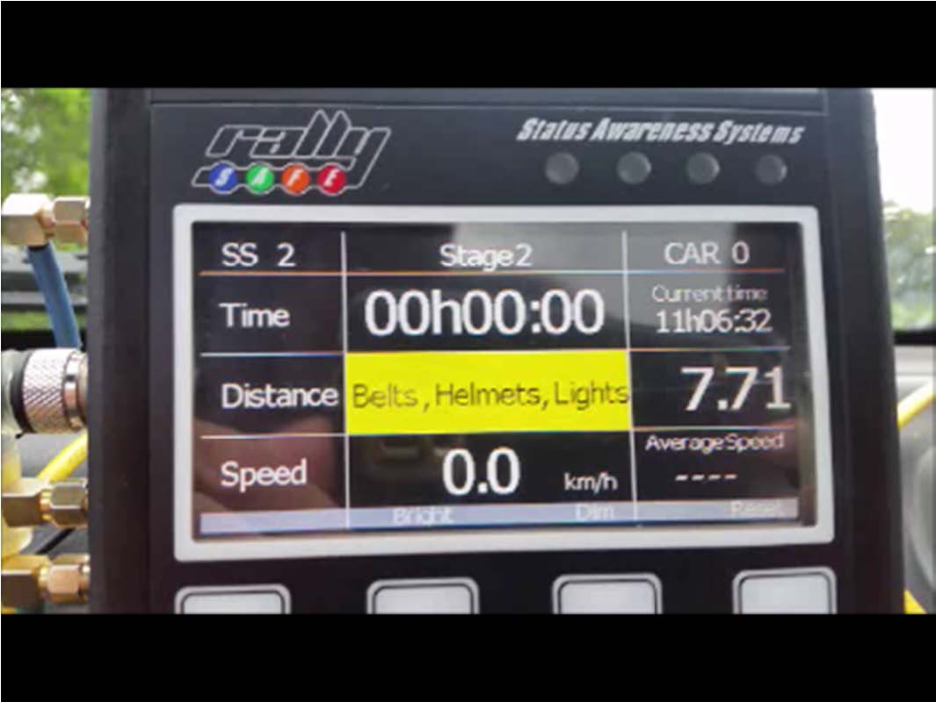
Checked In and Moving to Start Line
After you have checked in and are moving towards the start line the screen will display a reminder to check your safety items.
The stage number is displayed
The time is automatically reset
The middle buttons change their function to enable you to brighten or dim the display

Slide 29
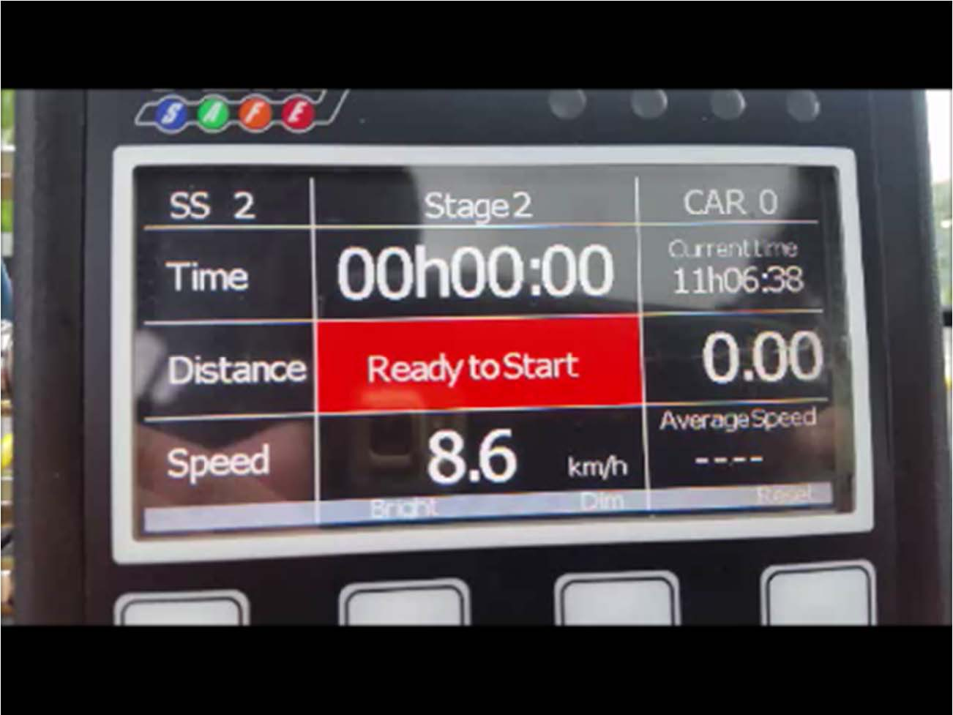
At the Start Line
When you arrive at the start line the display will advise you “Ready to Start”
The Odometer automatically resets to zero

Slide 30
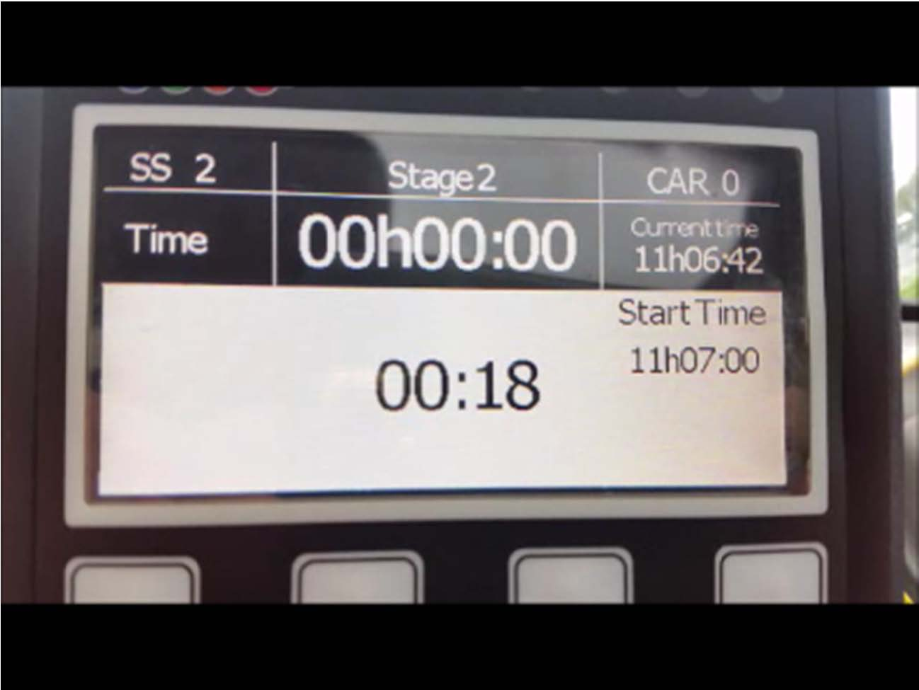
Start Line Countdown
If the event is using this function (and this event is), a start time will be allocated to your unit by the Start Marshal , you will write this on your time card.
This time will be displayed to the right of the white section of the screen
Make sure it matches the time as entered on your time card.
The countdown in seconds is displayed after the start marshall enters it on the tablet. There may be a slight delay.

Slide 31
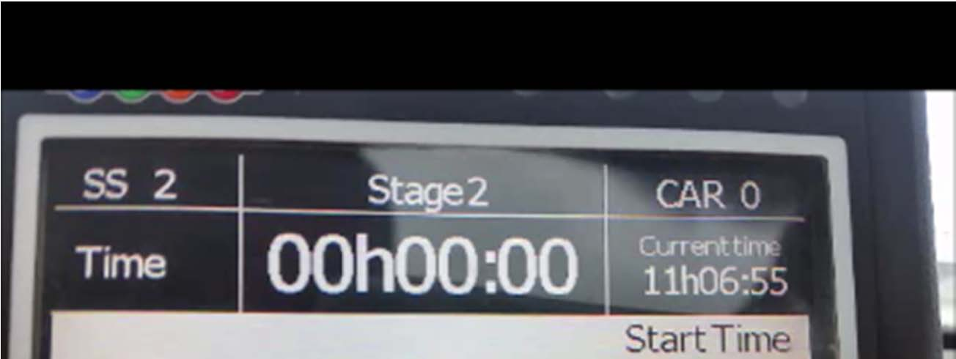
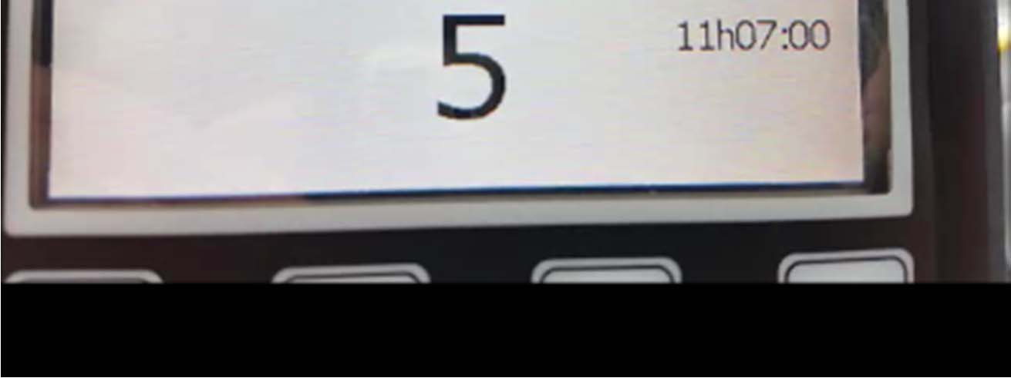
The Countdown
With 5 seconds to go the countdown increases in size.
The co-driver should countdown 5, 4, 3, 2, 1
If there is a glitch and the countdown doesn’t work – DON’T PANIC!
There is a clock in your Rallysafe Unit – “Current Time”. You can do a manual countdown from this.
You will know your due start time because it’s written on your time card.

Slide 32
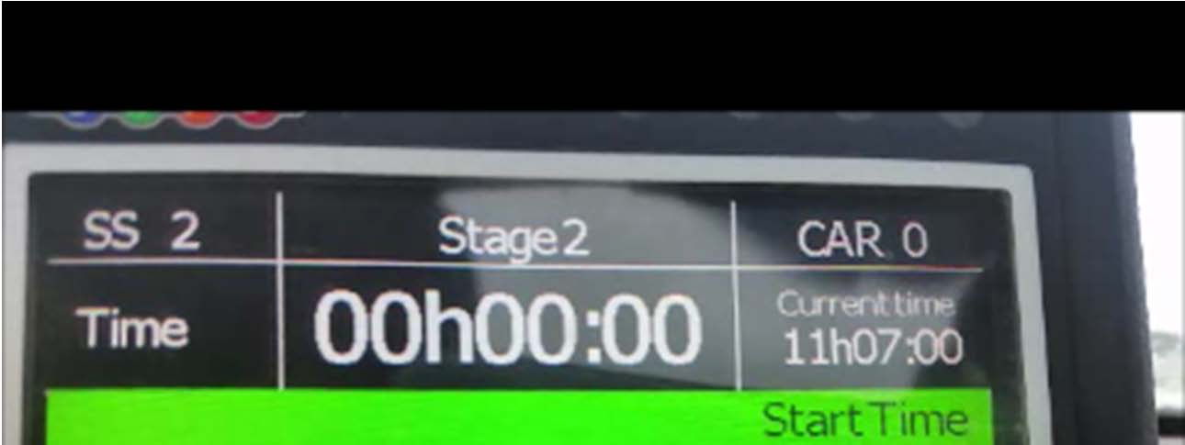
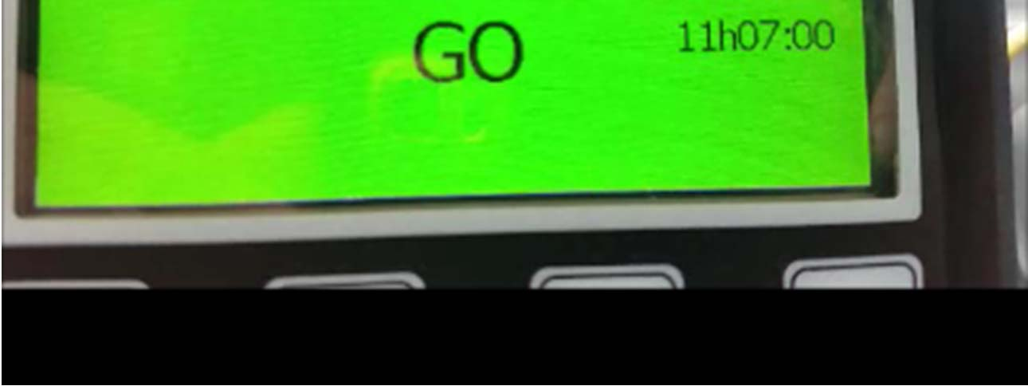
GO
At your due start time “GO” will be displayed and the screen will go green.
Remember, the unit will record and transmit to rally control the actual time you start the stage.
Jumped starts are verified by Rallysafe data, analysed at HQ.

Slide 33
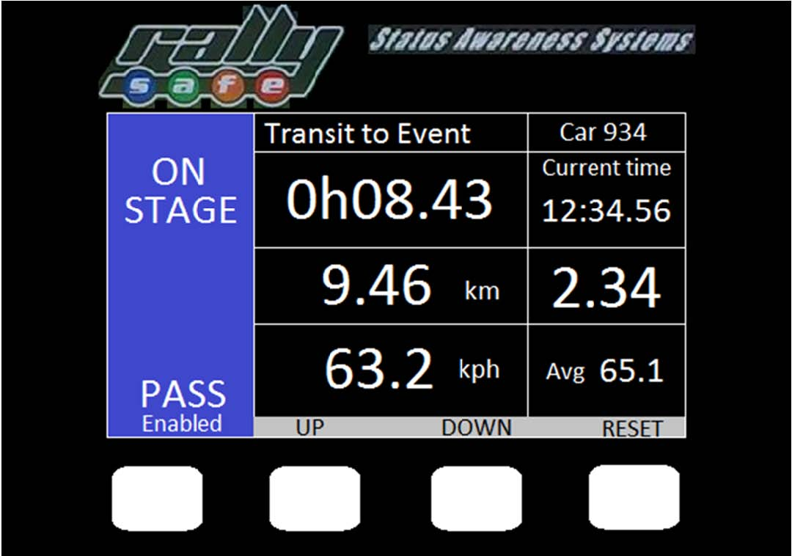
In Stage
The unit displays (from left to right, top to bottom):
The elapsed time
Rally time
Odometer
Speed

Slide 34
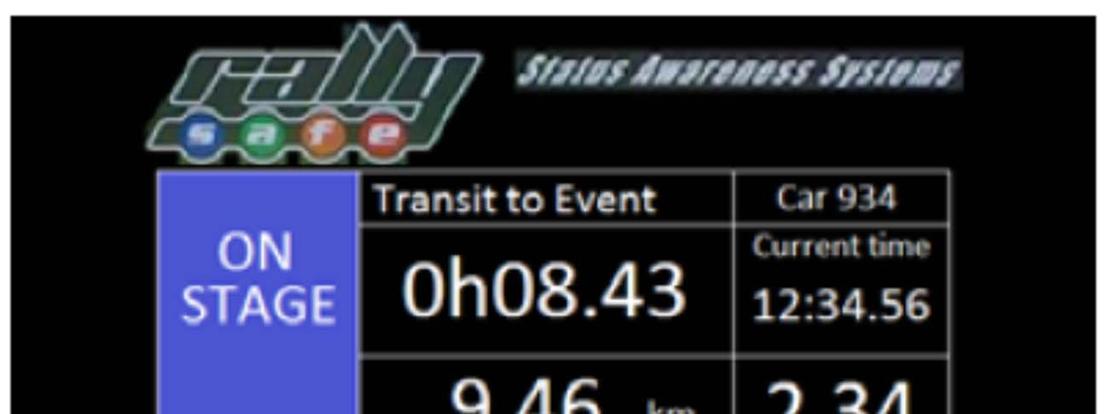
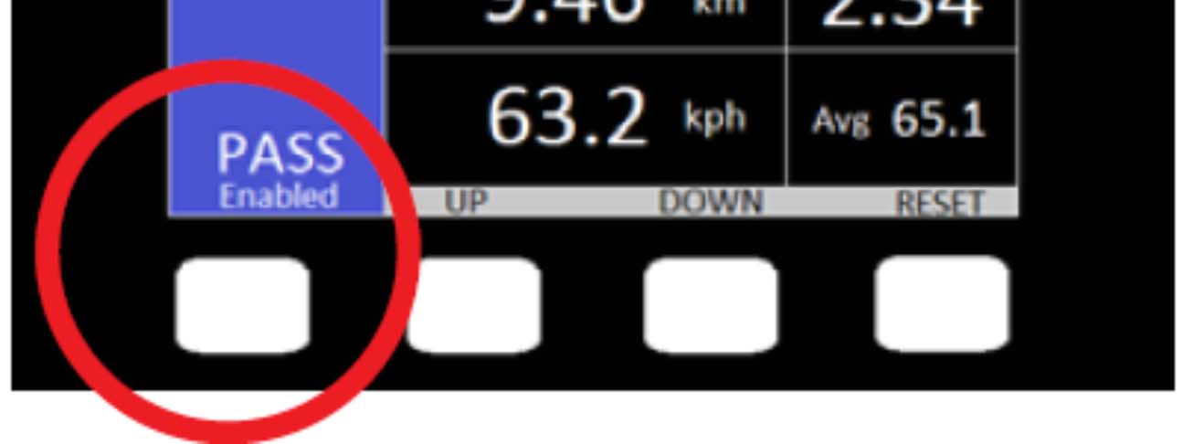
Push to Pass
The left hand button allows the crew to transmit a pass request to the car in front.
This can only be received by the car in front when you get to within 500m

Slide 35


Push to Pass enabled
Once you have pressed the push to pass button the screen changes to Transmitting Overtake and sends your speed to the car in front.

Slide 36
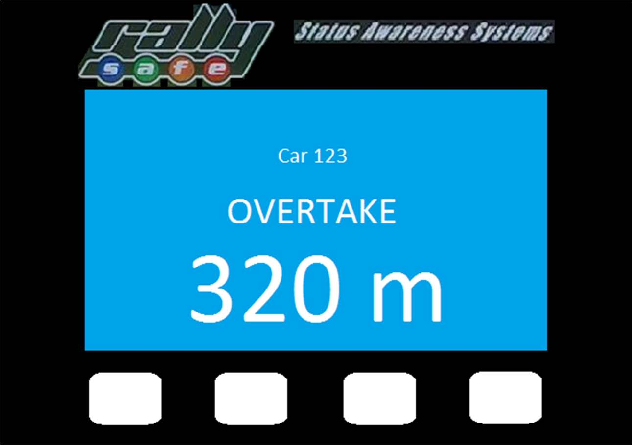
Overtake Request
The overtake request is displayed in the car in front of you.
The car number requesting the overtake and the distance behind are displayed.
When you think you are within 400m of the car in front, select the push to pass button to alert the car in front you are catching them.
When you get to within 50m or so and are ready to pass select push to pass again.
NOTE: The car in front still has to find somewhere safe to pull over so you can pass safely. However remember, if you are receiving a pass request, and can see the car behind you, deliberately refusing to allow the pass is a penalty offence.

Slide 37
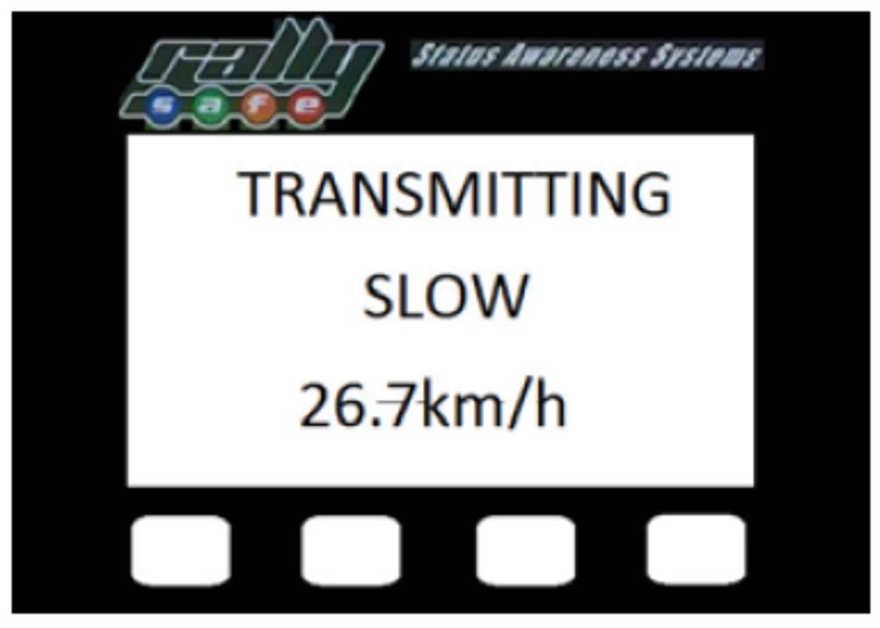
Transmitting Slow
If you slow down for any length of time, you will see this on your display.

Slide 38
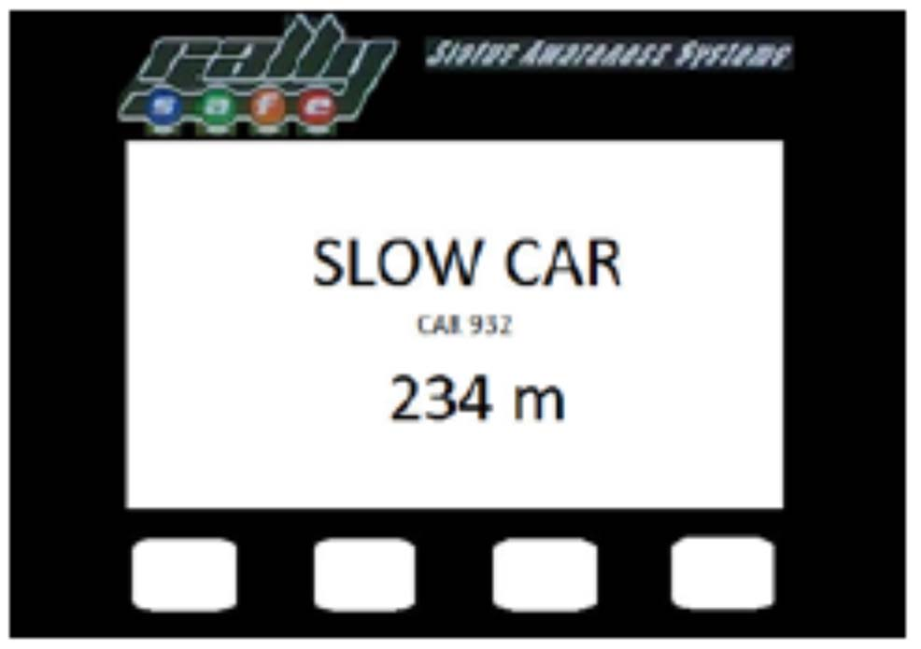
Receiving Slow
The car behind, when it gets close enough, will get this display:
The car number
The distance ahead to the car

Slide 39
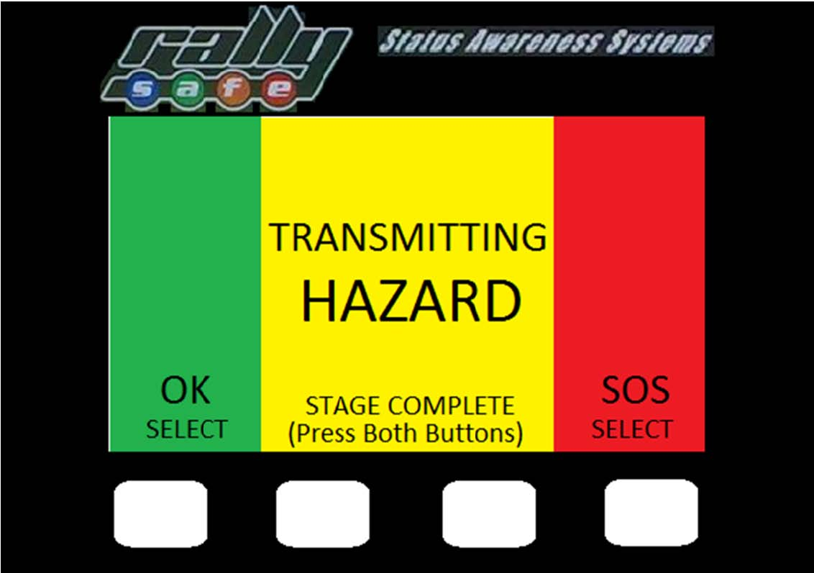
Hazard
If you stop, spin, overshoot a corner etc, this screen will be displayed.
It advises oncoming cars that you are a hazard to them.
It is also displayed in rally control. If you get moving again then it will automatically cancel out.
If you are okay and about to get mobile again, select the ‘OK’ button under the green display.
If you are on or across the road and a hazard to other cars, leave it yellow. Then put out your Safety Triangle.
NOTE: Rallysafe does NOT take the place of your emergency instructions. You must still put out your safety triangle and display your okay sign.

Slide 40


Receiving Hazard
The approaching vehicle will get this hazard advice – yellow screen.
The car number and distance to the hazard are displayed.
The distance to the hazard will reduce as you get closer.

Slide 41
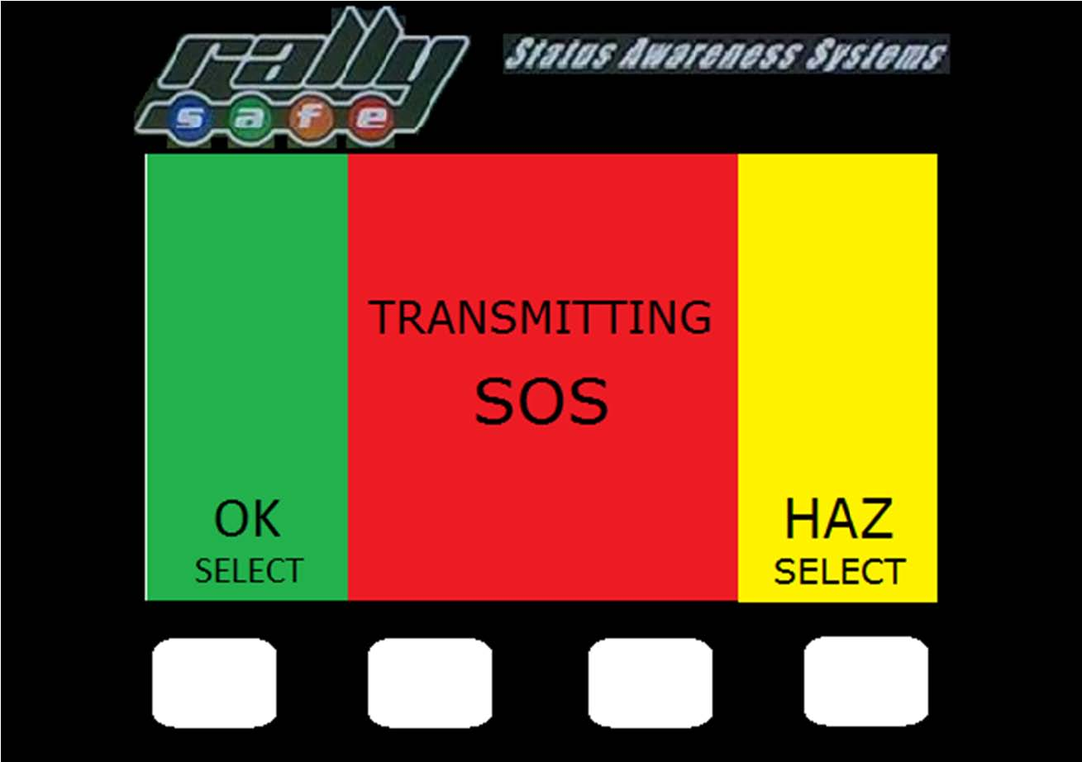
SOS
Should you have an incident over 12G’s or roll over, the unit will go red and automatically transmit SOS.
If you need assistance select either of the two centre buttons.
A message will appear, asking you if your require “fire or medical” – you can answer “yes” or “no” using the buttons
If you are able to, put out your Safety Triangle and if necessary use your SOS sign to obtain help from the next cars.
If you are stopped monitor the unit, Rally Control may send you a message.
If you are okay, but a hazard to other cars then select “HAZ” to downgrade the screen to yellow hazard.

Slide 42


SOS Receipt
The following car will receive a red screen with the car number and the distance away.
If the rallysafe unit advises you of an SOS, then Rally Control will know about it and be on standby.
You, as the next competitor are expected to know and follow the accident procedure as outlined in the road book.
If Medical or Fire assistance is required, select SOS on your unit. If for some reason the crashed car did not report the incident, then your car will.
Stop as many cars as required to assist and ensure someone goes to the next radio point with the details of the incident.

Slide 43
NOTES Regarding an SOS incident
Once you have enough cars send all other cars on by displaying the “OK” as provided in the road book.
Things to consider when coming across an incident.
  Park your car to the side – DON’T block the road. It will also ensure you don’t get run into!
  Ensure you put out your Safety Triangle.
  As you stop other cars, make them pull over as well to keep the road clear.
  All the other cars that are in the stage behind you will need to get past so the emergency vehicles can get to the incident.
Messaging
Rally Control can send messages, these may be questions or advice. They will show on your screen and you will need to respond by selecting “yes” or “no”.

Slide 44
Any final questions?
Notes:
Make sure you hang around to answer questions for anyone not prepared to ask in a public forum.

